Slide 1

GENERATIVE AI
Reshaping Future

Slide 2
Agenda
1
Introduction
2
How GenAI works?
3
Examples of GenAI
4
Advantages of GenAI
5
Applications of GenAI
6
Ethical Concerns of GenAI

Slide 3




Ehtisham Raza
I am AI/ML Engineer working in a FinTech having 3+ years of experience and solving financial problems using artificial intelligence and machine learning.
Ehtisham Raza
AI/ML Engineer
Data Trainer & Coach at AnalystsHQ
Ehtisham Raza

Slide 4
Introduction
WHAT IS GENRERATIVE AI?

Slide 5
WHAT IS GENERATIVE AI?
Generative AI is a type of artificial intelligence (AI) that used machine learning algorithms to create new and original content like image, videos, text and audio
Utilizes machine learning algorithms to create new content such as images, music and text
Simulate complex events, predict outcomes and produce high quality content that rivals human creativity
Has made a significant impact on contemporary culture: innovative, high quality material rapidly and cost effectively
Set to merge as a dominant force, redefining creativity and innovation

Slide 6
WHAT IS GENERATIVE AI?
Forming a Database
A neural network consisting of various information or media files like images, text data, sounds etc. forms the basis of artificial intelligence
Inputting a Prompt
The user provides the AI with a description or sample of the desired content. Prompt can be any user submitted material like words, numbers or photos
Generating Content
AI uses its neural network to generate new examples that are similar to the ones it has trained from

Slide 7
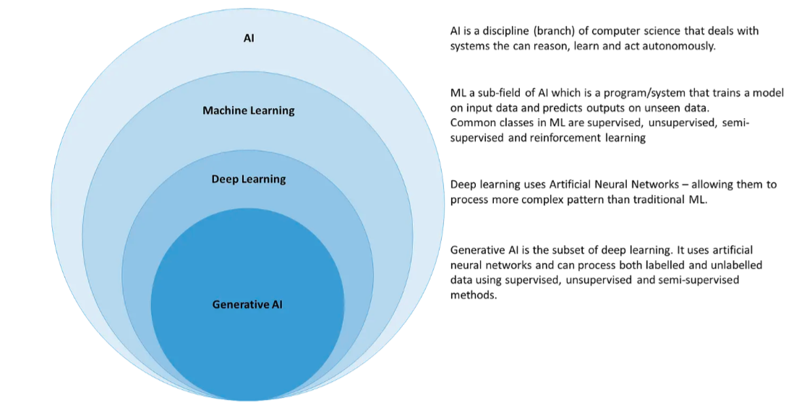
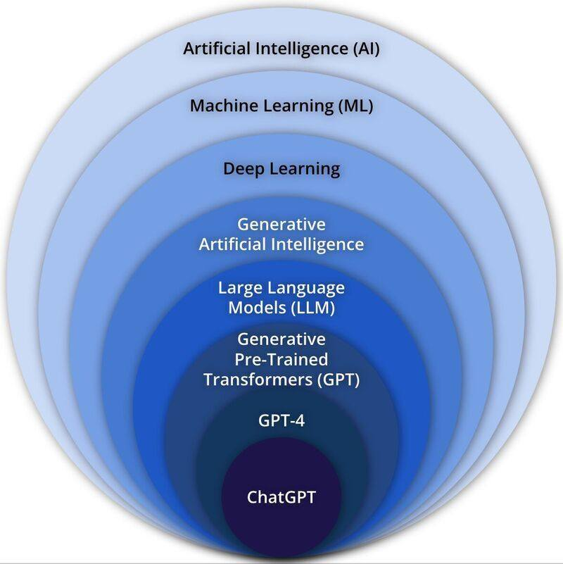
WHAT IS GENERATIVE AI?
Forming a Database
A neural network consisting of various information or media files like images, text data, sounds etc. forms the basis of artificial intelligence
Inputting a Prompt
The user provides the AI with a description or sample of the desired content. Prompt can be any user submitted material like words, numbers or photos
Generating Content
AI uses its neural network to generate new examples that are similar to the ones it has trained from

Slide 8
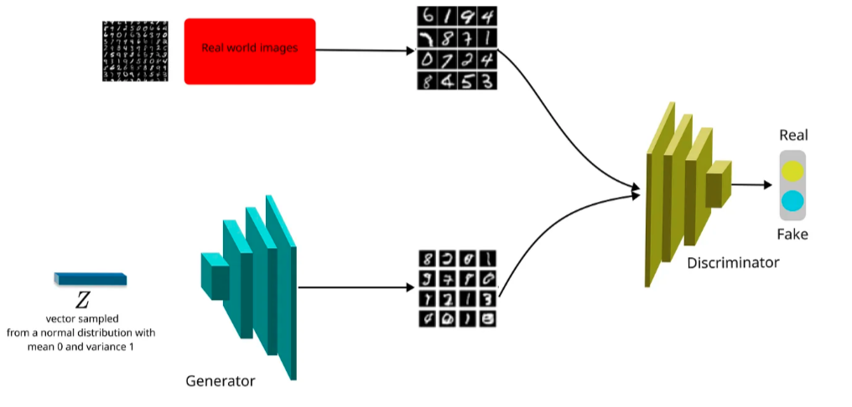
HOW GENERATIVE AI WORKS

Slide 9
WHAT IS GENERATIVE AI?
Two Neural Networks:
Generator Network – Creates new data based on the input it receives from the dataset
Discriminator Network- Evaluates whether the generated data is real or fake
Adversarial Training – Trained on a large dataset until the generator can create realistic data that can fool the discriminator

Slide 10
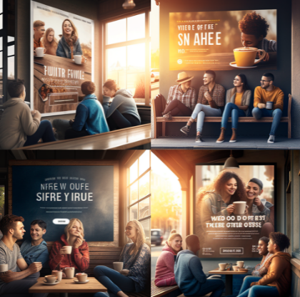
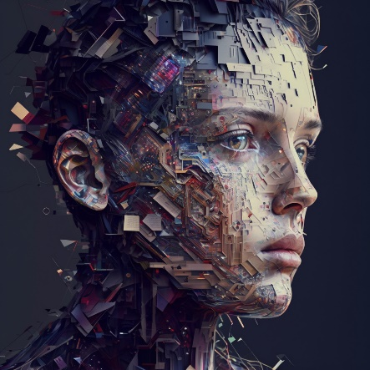
EXAMPLES OF GENERATIVE AI
Mid Journey for Image Generation
Input Prompt
billboard ad design for a coffee shop, group of
friends sitting in a coffee shop, warm daylight ambiance
Input Prompt
AI-based art generators

Slide 11
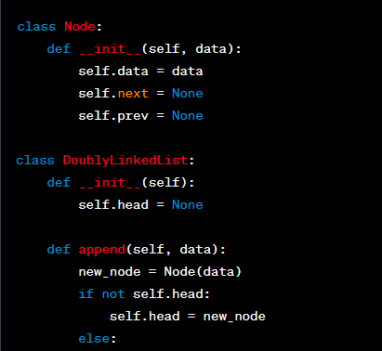
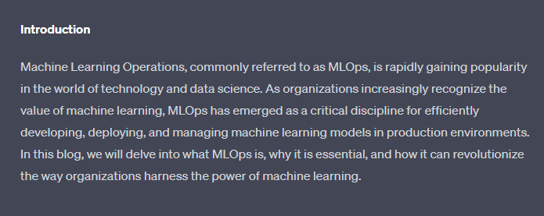
EXAMPLES OF GENERATIVE AI
ChatGPT for Text Generation
Input Prompt
give me a code for double linked list in python
Input Prompt
write a blog on MLOPS

Slide 12
ADVANTAGES OF GENERATIVE AI
Boosts Creativity and Innovation
Analyzes vast amount of data to extract patterns and insights that can be used to create new and original concepts
Used in music and art to produce unique pieces
Generates new product designs or improve existing ones
Increases Production Efficiency
Automates many of the design and production processes
Reduces time and resources required to produce a product
Provides cost-effectiveness benefits
Creates a large amount of original content quickly and efficiently
Reduces the need for a large team of writes, designers and artists

Slide 13
APPLICATIONS OF GENERATIVE AI CREATIVE INDUSTRIES
Generative Al applications are having a significant impact on the creative industries by offering new ways to generate art, music, and literature. Here are some of the ways in which creative industries are benefiting from generative Al:
Novelty: creating novel artworks, music pieces or literature
Efficiency: automate the creation process and generate new content quickly
Personalization: creating content that is tailored to individuals, considering their preferences and interests
Collaboration: facilitating collaboration between humans and machines
Exploration: artists and creators explore new creative territories
Jobs: prompt engineers - creative input generates creative output

Slide 14
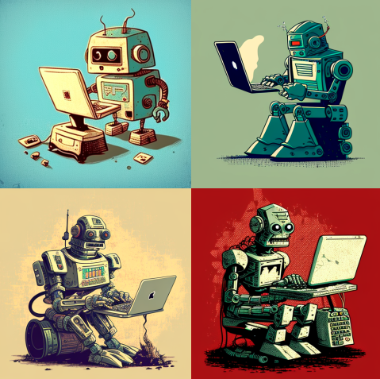
APPLICATIONS OF GENERATIVE AI CREATIVE INDUSTRIES :ART
Generative Al is a supplementary tool that artists can use to explore new possibilities.
Digital Photography & Images
Midjourney
Marketing & Advertising
DALL-E 2 by OpenAl
Enhance visualizations
Create new designs

Slide 15
APPLICATIONS OF GENERATIVE AI CREATIVE INDUSTRIES :MUSIC
Music Composition: create original music pieces by analyzing existing music and generating new melodies and harmonies
Music Arrangement: create arrangements of existing music pieces by generating new versions with different instruments, tempo, and other musical parameters
Music Production: creating new sounds and textures
Amper Music by Shutterstock
Music Recommendation: recommendations based on the user's listening history and preferences.
Spotify - AI DJ by OpenAl
Music Visualization: creating visual representations of music
WZRD

Slide 16
APPLICATIONS OF GENERATIVE AI CREATIVE INDUSTRIES :LITERATURE
Al language models such as GPT-4 are being used to assist human authors in writing books.
Platforms such as Boom and Copy.ai use Al to generate entire books or assist with various writing tasks.
The use of Al in writing provides a cost- effective and efficient way to produce books on demand.

Slide 17
APPLICATIONS OF GENERATIVE AI HEALTHCARE INDUSTRY
﻿Drug Discovery
Generative Al is contributing to the research of rare diseases and future medicine
AlphaFold - DeepMind's protein structure program successfully generated nearly all 200 million protein images that are known to exist
Medical Imaging Analysis
Al is a popular tool to predict lung cancer, breast cancer, prostate cancer and the regrowth of tumors
Sybil - predicting lung cancer over 6 years in advance
Al is currently being tested on detecting early stages of breast cancer and maternity on mobile ultrasound devices

Slide 18
APPLICATIONS OF GENERATIVE AI HEALTHCARE INDUSTRY
Personalized Medicine:
Genomic Data Analysis: AI analyzes a patient's genetic data to personalize treatment plans, predict disease risks, and identify suitable drug options.
Pharmacogenomics: AI helps match medications to a patient's genetic makeup, optimizing drug efficacy and minimizing adverse reactions.
Disease Diagnosis and Prediction:
Diabetes Management: AI assists in continuous glucose monitoring and insulin dosing for diabetic patients, improving disease management.
Alzheimer's Disease Prediction: AI analyzes medical records and biomarkers to predict Alzheimer's disease in patients before symptoms manifest.
Drug Side Effects Prediction:
AI models predict potential side effects and adverse reactions of drugs, enhancing medication safety.

Slide 19
Transforming Unstructured Data into Clinical Protocols Using Generative AI
Unstructured data, such as medical documents in PDF format, often contain valuable clinical insights buried within. Generative AI, we can unlock this untapped potential and streamline clinical protocol creation.
Process Overview:
Data Collection: Gather diverse clinical documents, including PDFs.
Data Preprocessing: Extract and clean text content to remove formatting and noise.
AI Model Training: Train a Generative AI model on the preprocessed data.
Pattern Detection: Utilize the trained AI model to identify key patterns within the data.
Clinical Protocol Generation: Generate structured clinical protocols from the detected patterns.
Benefits:
Efficient: Accelerates protocol creation by automating the extraction of relevant information.
Consistent: Ensures standardization and consistency in protocol development.
Data-Driven: Harnesses the power of data for evidence-based protocol creation.

Slide 20
Transforming Unstructured Data into Clinical Protocols Using Generative AI
Applications:
Creating treatment guidelines, surgical procedures, and patient care protocols.
Enhancing clinical decision support systems with AI-generated insights.
Conclusion:
Generative AI empowers healthcare professionals by transforming unstructured data into actionable clinical protocols, ultimately improving patient care and healthcare efficiency.

Slide 21
EHTICAL CONCERNS OF GENERATIVE AI
﻿Employment Opportunities
Possible chance of Al automated tasks/processes displacing human capital Customer service representatives
Programmers since Al can generate codes
Deepfake harassment or defamation could depict them in a negative light
Effects on Personal Privacy
Can be used to create realistic and convincing social engineering attacks
Phishing emails and phone calls
Trick individuals into giving out sensitive information:
Login credentials, financial information
Trick someone into downloading malware

Slide 22
Any Questions?

Slide 23
Thank You

